Slide 1
Antibiotics in Newborns: Each Day Matters
J.B. Cantey, MD, MPH
Ongoing Care of Congenital and
Perinatal Infections (OKAPI) Program

Slide 2
Objectives
1) To update providers about the pharmacokinetics and pharmacodynamics of antibiotics commonly used in the nursery
2) To describe antibiotic-specific side effects and toxicity
3) To describe the adverse effects of antibiotic exposure on the microbiome and subsequent health effects

Slide 3
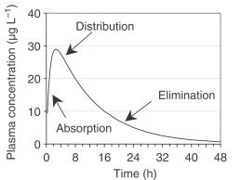
Pharmacokinetics

Slide 4
Pharmacokinetics
Peak
[C]_{max}
T_{max}

Slide 5
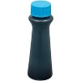
Distribution
Depends on a variety of things:
Mode of delivery (IV faster than PO)
Dose of drug (higher dose = higher peak)
Volume of distribution

Slide 6
Pharmacokinetics
[C]_{1/2}
Trough
T_{1/2}

Slide 7
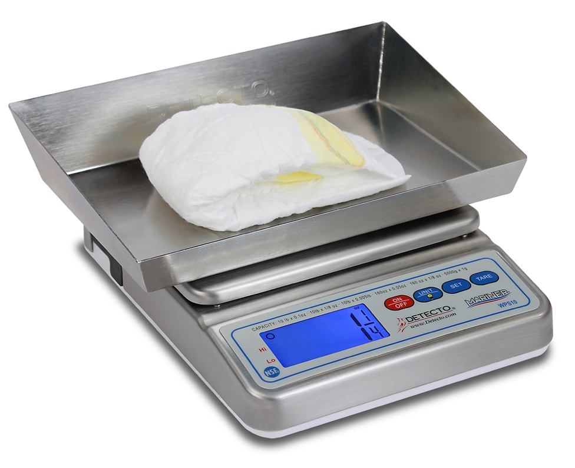
Elimination
Depends on a variety of factors
Renal and/or hepatic clearance
Binding of drug to proteins (slows clearance)
Half-life of drug
Frequency of dosing

Slide 8
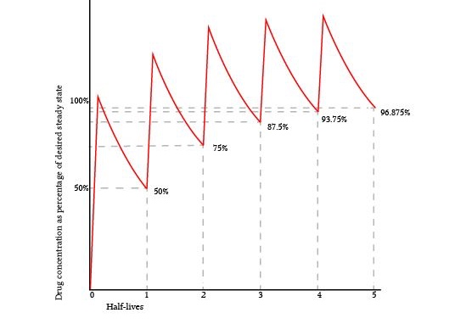
Steady-state
Classically described as achieved after 4 to 5 half-lives of drug…
…but neonates do not have stable clearance or volume of distribution

Slide 9
In the first 7-10 days after delivery:
Infants lose 7-12% of their body weight (changing dose)
Mostly extracellular water (changing volume of distribution)
Begin to mature their renal and hepatic clearance systems (changing excretion)

Slide 10
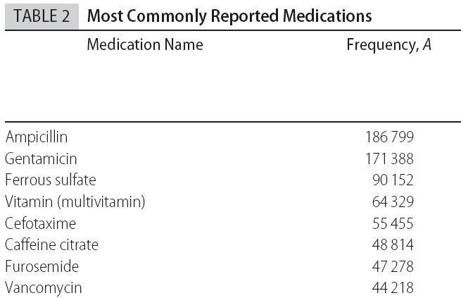
Antibiotics in the Newborn Nursery
Number receiving at least one dose out of 208,459 patients
Clark et al. Pediatrics 2006

Slide 11
Ampicillin
Has activity against all streptococci (including GBS), Listeria, and Enterococcus.
Ampicillin resistance is common among E. coli and other enteric gram-negative bacilli.
Pharmacodynamics: Time above MIC (time-dependent)
Toxicity: Minimal unless prolonged (weeks)
GA ≤ 34 weeks |  | GA ≥ 35 weeks
Age ≤ 7 days | Age 8-28 days | Age ≤ 7 days | Age 8-28 days
50 mg/kg IV q12 | 75 mg/kg IV q12 | 50 mg/kg IV q8 | 50 mg/kg IV q8

Slide 12
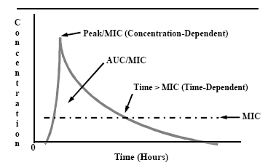
Ampicillin

Slide 13
Gentamicin
Has activity against enteric gram-negative bacilli (E. coli, Klebsiella, etc).
Can be synergistic against gram-positives (GBS, Listeria) when given with ampicillin but not used as monotherapy for those organisms
Pharmacokinetics: Cmax:MIC ratio (concentration-dependent)
Toxicity: Nephrotoxic, ototoxic (trough-dependent)
GA ≤ 29 weeks |  | GA 30-34 weeks |  | GA ≥ 35 weeks
0-14 days | >14 days | 0-10 days | >10 days | 0-7 days | >7 days
5 mg/kg q48 | 5 mg/kg q36 | 5 mg/kg q36 | 5 mg/kg q24 | 4 mg/kg q24 | 5 mg/kg q24

Slide 14
Gentamicin
Ampicillin

Slide 15
Cephalosporins
Ceftriaxone, cefotaxime (3rd generation)
Cefepime (4th generation)
Have activity against most gram-negative enteric bacilli, Neisseria gonorrheae, and GBS; cefepime also has activity against Pseudomonas
No activity against Listeria, Enterococcus
Cross blood-brain barrier (unlike gentamicin)
Pharmacodynamics: Time above MIC (time-dependent)
Toxicity: Minimal unless prolonged (weeks)

Slide 16
Gentamicin
Ampicillin
Cephalosporins

Slide 17
Vancomycin
Effective against virtually all gram-positive organisms, including Staphylococci and Streptococci, Enterococcus
No activity against Listeria or gram-negative organisms
Less effective than beta-lactams against susceptible organisms (eg, oxacillin > vancomycin for MSSA, ampicillin > vancomycin for GBS)
Pharmacodynamics: AUC to MIC ratio (time and concentration)
Toxicities: Nephrotoxic

Slide 18
Gentamicin
Vancomycin
Ampicillin
Cephalosporins

Slide 19
Common nursery indications
Suspected or proven early-onset sepsis: Ampicillin/Gentamicin
Cephalosporins reserved for severe renal dysfunction OR suspected/proven meningitis
Congenital syphilis – Penicillin
Gonococcal prophylaxis (all infants) – Erythromycin ointment
No activity against Chlamydia trachomatis
Gonococcal prophylaxis (mothers with untreated infection) – Cephalosporin x1
Vancomycin rarely if ever indicated for early-onset sepsis; more commonly used for late-onset infection in the NICU setting

Slide 20
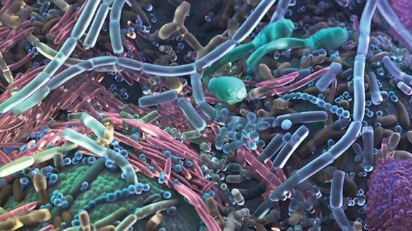
Microbiome

Slide 21
Microbiome

Slide 22
Diversity = Good
Transfer of bacteria begins in-utero; the placenta, amniotic fluid, and meconium are not sterile
Maternal antibiotic exposure affects infant microbiome – less diversity with maternal antibiotics
Gestational age affects infant microbiome – less diversity at earlier gestational ages
Delivery mode affects infant microbiome – less diversity with cesarean delivery
Postnatal feeding affects microbiome – less diversity with formula feeding

Slide 23
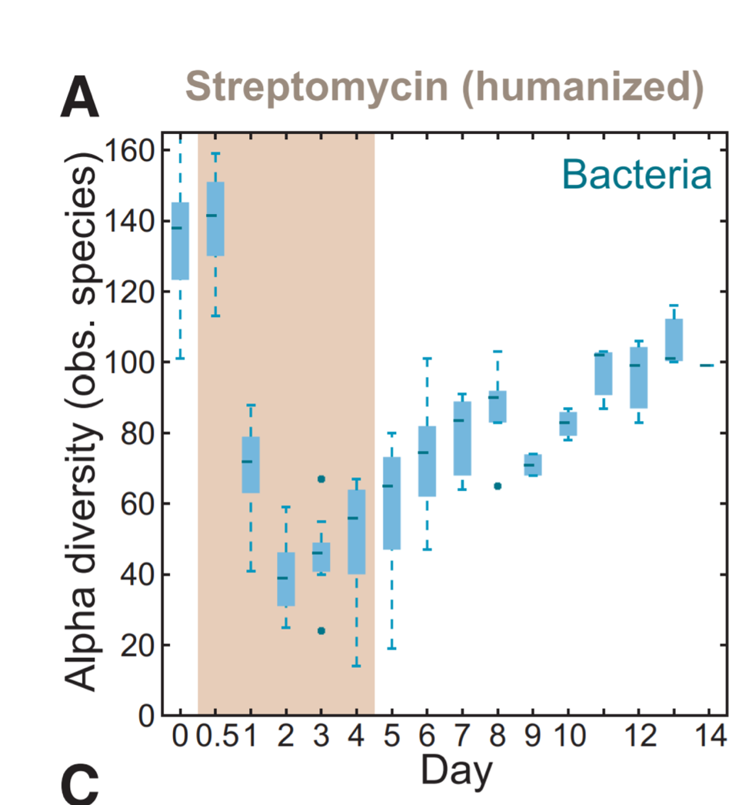
Antibiotic disruption of the microbiome
Following even a single dose of antibacterial therapy, there is a significant loss of number and diversity of bacteria in the gut
This “dysbiosis” takes weeks to months to recover from
Similar effects seen in the lung and cutaneous microbiome

Slide 24
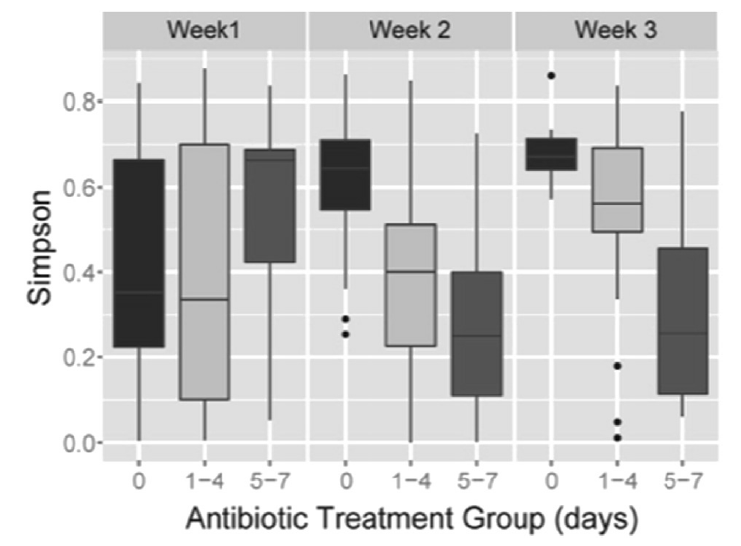
Antibiotic Effects on Gut Microbiome
Greenwood et al, J Pediatr 2014
Stool samples collected from 74 infants ≤32 weeks gestation
Infants stratified by initial antibiotic duration (0, 1-4, ≥5 days)
Higher proportion of Proteobacteria and less microbiome diversity (Simpson index) in infants who received antibiotics

Slide 25
Antibiotic Effects on Gut Microbiome
Rooney et al, Clin Infect Dis 2019
16S rRNA sequencing of stool swabs collected from 72 NICU infants after completing antimicrobial therapy
Most infants received ampicillin and an aminoglycoside
Each additional day of antibiotics reduced richness and diversity of anaerobes (RR 0.84 [95% CI 0.73-0.95])

Slide 26
Antibiotic Effects on Lung Microbiome
Lohmann et al, Pediatr Res 2014
Tracheal samples from infants ≤32 weeks gestation collected on day 1, 3, 7, 28
Reduced diversity on day 1 = ↑ risk for BPD
Correlated with maternal and infant antibiotic exposure
Prevalence of Proteobacteria in samples correlated with increased risk for BPD

Slide 27
Dysbiosis

Slide 28
Dysbiosis
This loss of diversity is associated with a variety of adverse outcomes even in term* newborns
Increased risk for Candida colonization/infection
Saiman et al, PIDJ 2001
Cotten et al, Pediatrics 2006
Lee et al, PIDJ 2012
Increased risk for colonization/infection with multi-drug resistant organisms
de Man et al, Lancet 2000
Carr et al, Arch Dis Child Fetal Neonatal Ed 2017
Ramirez et al, Neoreviews 2019
Atopic disease (asthma, eczema)
Donovan et al, Clin Infect Dis 2019
Ni et al, BMC Pediatr 2019
Ahmadizar et al, Ped All Immunol 2017
Obesity, Metabolic Syndrome, and Diabetes
Block et al, Pediatrics 2018
Bailey et al, JAMA Pediatr 2014
Jess et al, Sci Rep 2019
Singer-Englar et al, Expert Rev Gastro Hepatol, 2019
Primary risk factor in all these studies is duration of therapy – each day increases risk
*Preterm infants also at increased risk for necrotizing enterocolitis, late-onset sepsis, and death

Slide 29
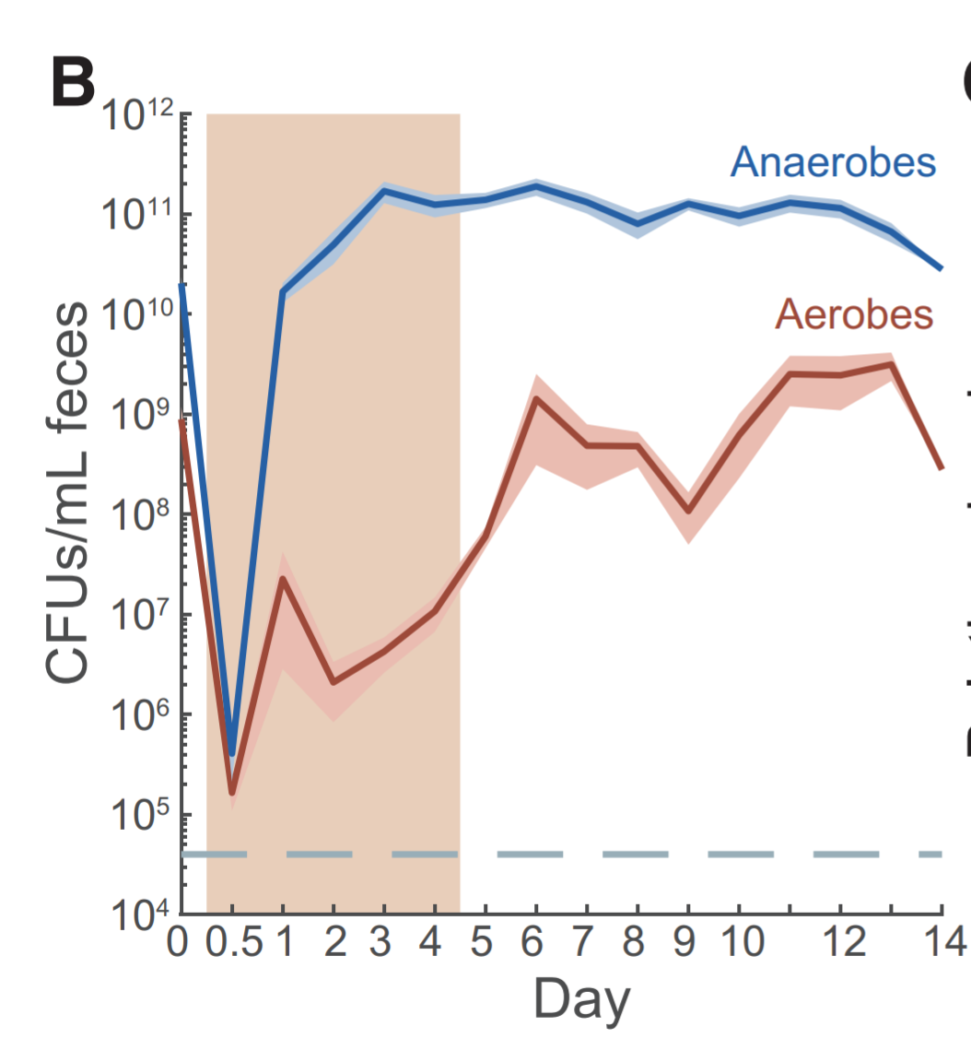
Resistance
Develops after ≥1 dose
Selective pressure supports expansion of resistant organisms
Killed bacteria release resistance genes for living bacteria to acquire (plasmids)
Suppressed genes activated on bacterial chromosomes

Slide 30
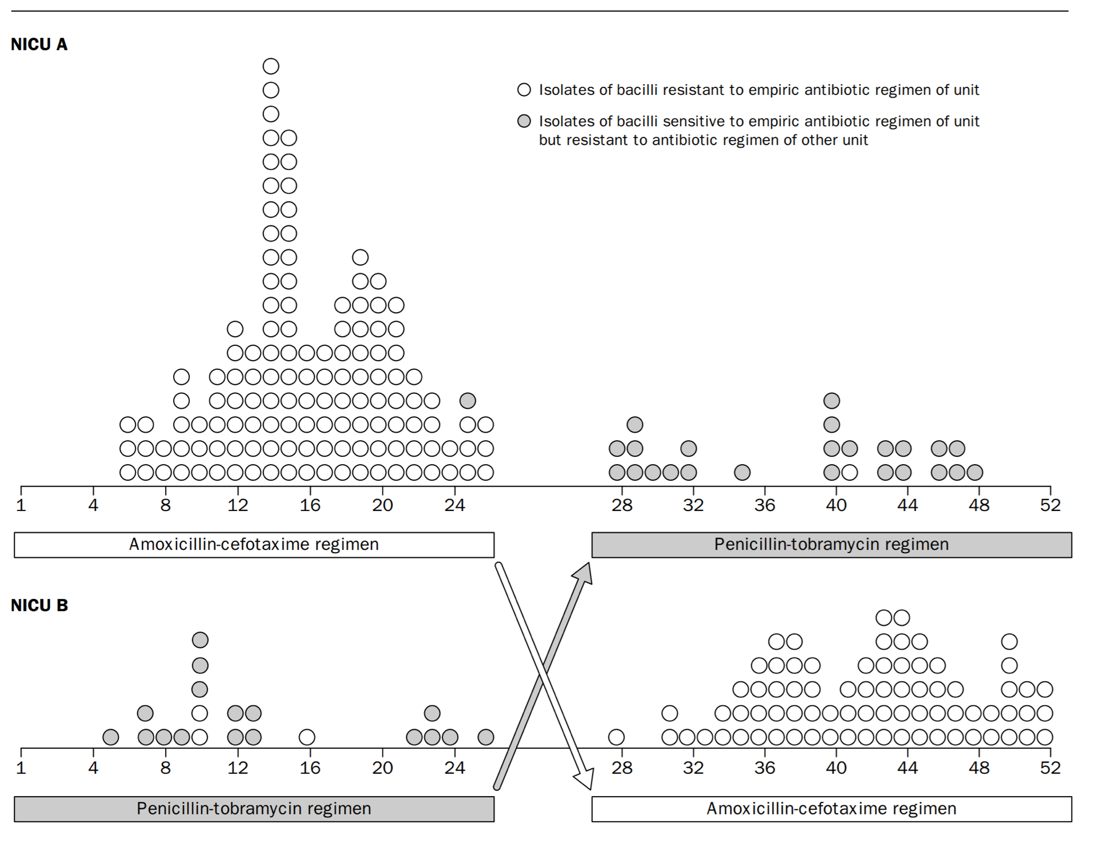
de Man et al, Lancet 2000

Slide 31
Probiotics?
Encouraging animal data and limited clinical experience
Largest study to date in German NICUs (time-series analysis, not randomized controlled trial) demonstrated reduction in necrotizing enterocolitis and death with routine supplementation of Lactobacillus acidophilius and Bifidobacterium sp.
BUT… no FDA-approved product in US, and case reports of sepsis and death due to probiotic products
Mucormycosis following ABC Dophlus powder (UConn)
Saccharomyces cerevisiae sepsis in preterm infant (Kolkata, India)
Lactobacillus sepsis (Florence, Italy)
Et cetera

Slide 32
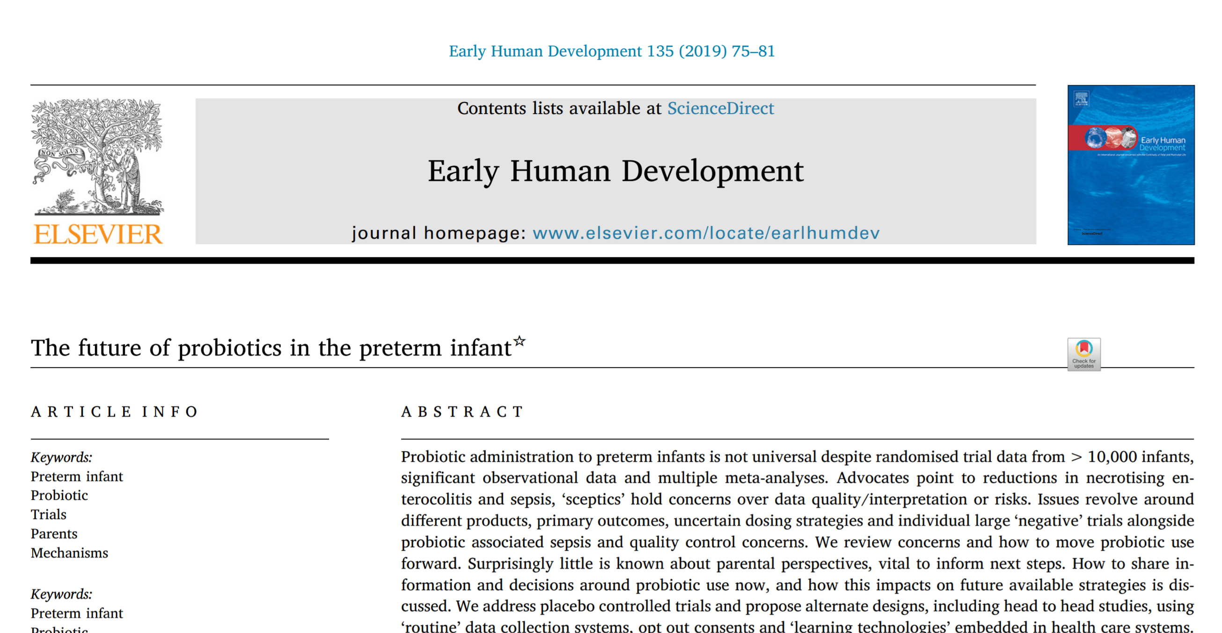
Barrington JE, et al. Early Hum Dev 2019

Slide 33
My take:
Antibiotic stewardship
Probiotics

Slide 34
Conclusions – Antibiotic use
Antibiotics are among the most frequently-prescribed medications in the nursery setting
Ampicillin, gentamicin, and penicillin account for vast majority of level 1 nursery antibiotics
Beta-lactams generally well tolerated; gentamicin nephrotoxic if it accumulates
Broad-spectrum therapy (cephalosporins, vancomycin, etc) should be avoided for early-onset sepsis except in specific circumstances
All antibiotic exposure drives antimicrobial resistance

Slide 35
Conclusions – Microbiome
Infant microbiome is a delicate ecosystem that can be disrupted by prenatal, intrapartum, and postnatal antibiotic exposure
Antibiotics are lifesaving when used for proven infection but should be avoided or minimized in other situations
Microbiome recovery from antibiotic exposure can be facilitated by reintroduction of healthy flora (skin-to-skin contact, breast milk feeds)
Likely a role for probiotics for microbiome protection/recovery but optimal regimen not yet identified

Slide 36
Email: cantey@uthscsa.edu
OKAPI Program: 210-880-9100
Twitter: @OKAPIProgram

