Slide 1
“Hot” Topics in Chorioamnionitis
J.B. Cantey, MD, MPH
Ongoing Care of Congenital and Perinatal Infections (OKAPI) Program

Slide 2
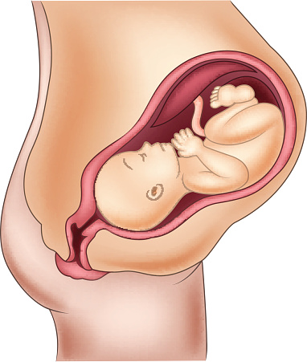
Chorioamnionitis
Defined as infection (and subsequent inflammation) of any or all of the decidua, chorion, amnion, amniotic fluid, or fetus.
Also known as intraamniotic infection, or intraamniotic infection and inflammation (triple-I)

Slide 3
ACOG 712
Confirmed (histological) chorioamnionitis
Positive culture of amniotic fluid and/or placental pathology showing chorioamnionitis
Suspected (clinical) chorioamnionitis
Mother ≥ 39 C
OR
Mother 38.0-38.9 C AND maternal leukocytosis, purulent cervical discharge, or fetal tachycardia
Isolated maternal fever
Mother 38.0-38.9 without other findings

Slide 4
Outline
Pathophysiology
Epidemiology
Obstetrical management
Neonatal management
Neonatal sequelae

Slide 5
Pathophysiology
Amniotic fluid is normally sterile
Physical barriers (chorioamnion, decidua, cervical mucous plug)
Immune barriers (decidual macrophages, anti-inflammatory cytokines, toll-like receptors, maternally derived IgG in amniotic fluid)
However, onset of labor (cervical shortening, loss of mucous plug) and/or rupture of membranes may allow bacteria to enter amniotic cavity

Slide 6
Pathophysiology
Although rupture of membranes is the most common predisposing factor, chorioamnionitis without rupture is possible
Direct invasion of intact membranes
Hematogenous spread via placenta

Slide 7
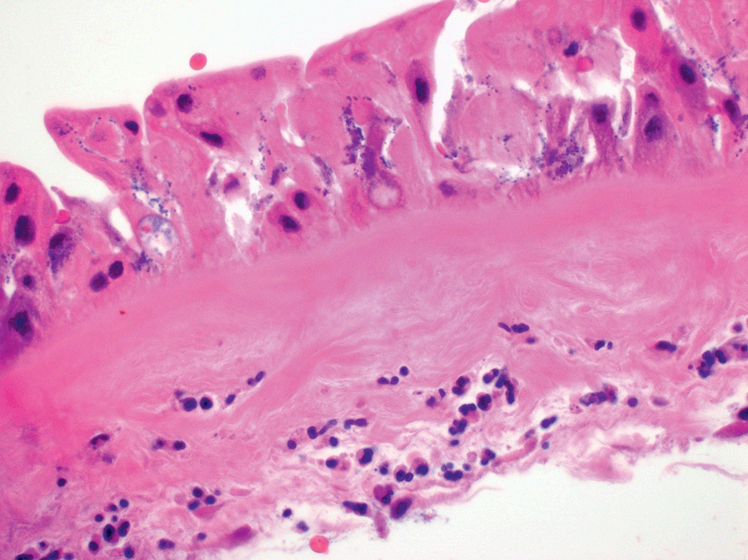
© Cambridge University Press

Slide 8
Introduction of bacteria from genitourinary tract

Slide 9
Introduction of bacteria from genitourinary tract
Infection ascends to choriodecidua, replicates, and invades OR directly invades the

Slide 10
Introduction of bacteria from genitourinary tract
Infection ascends to choriodecidua, replicates, and invades OR directly invades the
Amniotic cavity

Slide 11
Introduction of bacteria from genitourinary tract
Infection ascends to choriodecidua, replicates, and invades OR directly invades the
Amniotic cavity
Infant aspirates infected amniotic fluid, leading to pneumonia/sepsis

Slide 12
Pathogenesis - Organisms
Etiology of chorioamnionitis often polymicrobial
Most frequently identified:
Mycoplasma hominis
Ureaplasma sp.
Group B Streptococcus
E. coli and other enteric gram-negatives
Anaerobes
In contrast to neonatal sepsis, which is virtually always monomicrobial

Slide 13
Ureaplasma and Mycoplasma
Ureaplasma parvum and urealyticum as well as Mycoplasma hominis are common colonizers of the maternal GU tract
Have clearly been linked to histologic chorioamnionitis and postpartum fever
The role they play in clinical chorioamnionitis, neonatal sepsis and pneumonia, and late sequelae are unclear

Slide 14
Risk Factors for Chorioamnionitis
Duration of labor
Duration of rupture of membranes
Number of vaginal examinations
Use of intraamniotic monitors

Slide 15
Epidemiology
Reported incidence of chorioamnionitis ranges from 0.5-10% of all live births
Incidence is higher among preterm infants (15-40%)
These numbers exclude chorioamnionitis which is only detected on histopathology, when clinical signs are not apparent.

Slide 16
~2400 chorio-exposed infants with early-onset sepsis
80-200K mothers with chorioamnionitis
4,000,000 live births annually in United States

Slide 17
Clinical signs
Maternal fever AND ≥1 of the following:
Fetal tachycardia
Maternal leukocytosis (>15,000 cells/mm³)
Purulent cervical discharge
Amniotic fluid test results consistent with infection
Higgins et al. Chorio workshop. OBGYN 2016; 127(3): 426-36
ACOG Committee opinion 712

Slide 18
Clinical signs
Note: #4 may include histopathological examination of the placenta, but results generally not available in sufficient time to affect postnatal management of mother or infant
Histologic chorioamnionitis should NOT alter the management of the infant

Slide 19
Maternal management
Empiric antibiotic coverage
Usually ampicillin and gentamicin
Ampicillin 2 g IV q6
Gentamicin 2 mg/kg followed by 1.5 mg/kg q8 OR once-daily dosing 5 mg/kg
Cefazolin in lieu of ampicillin for mild penicillin allergy
Clindamycin or vancomycin for severe (anaphylaxis) penicillin allergy
Started at time of diagnosis and continued to delivery
1 post-delivery dose if cesarean delivery, including a dose of metronidazole or clindamycin

Slide 20
Infant management
Previous recommendations from the American Academy of Pediatrics for chorioamnionitis-exposed infants (sick or well appearing):
Obtain ≥1 mL of blood for culture,
Start antibiotics promptly, and
Obtain a complete blood count with differential +/- C-reactive protein at age 6-12 hours
Polin et al. Pediatrics. 2012; 129(5): 1006-15.

Slide 21
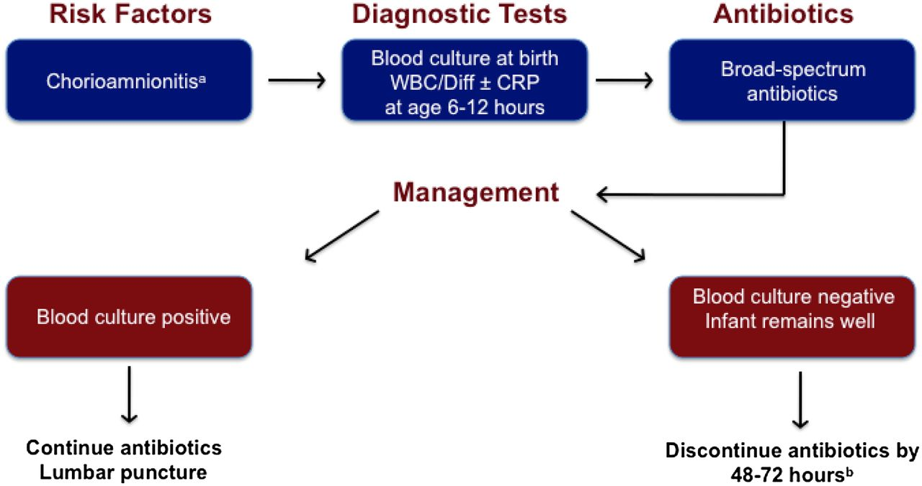
Polin et al. Pediatrics. 2012; 129(5): 1006-15.

Slide 23
Asymptomatic infants
Wortham et al. Pediatrics 2016; 137(1): e20152323.
Cohort of the 232 infants from the early-onset sepsis NICHD NRN study (Stoll et al, Pediatrics 2011) who were chorio-exposed
Aimed to determine the proportion of chorio-exposed infants with early-onset sepsis that are initially asymptomatic

Slide 24
Wortham et al. (con’t)
29 of 229 chorio-exposed infants with early-onset sepsis were asymptomatic through age 6 hours (13%)
Asymptomatic infants were more likely to be term (79% vs. 29%) and be born to mothers with fever alone (31% vs. 11%).
GBS was the predominant pathogen for initially asymptomatic infants

Slide 25
Wortham et al. (con’t)
Number needed to treat (NNT) for well-appearing, chorio-exposed infants for each case of early-onset sepsis:
Chorioamnionitis prevalence (%) | NNT
0.5% | 60
1% | 130
3% | 400
10% | 1400

Slide 26
Asymptomatic infants
Kaiser sepsis calculator provides additional evidence for observing well-appearing, term infant exposed to chorioamnionitis:
Kuzniewicz et al. JAMA Peds 2017; 171: 365-71
Money N, et al. J Perinatol, 2018; 38(6): 771-2.
Sharma V, et al. Glob Pediatr Health, 2019; available online 8 April.
Sloane AJ, et al. J Pediatrics 2019; available online 14 June.

Slide 27
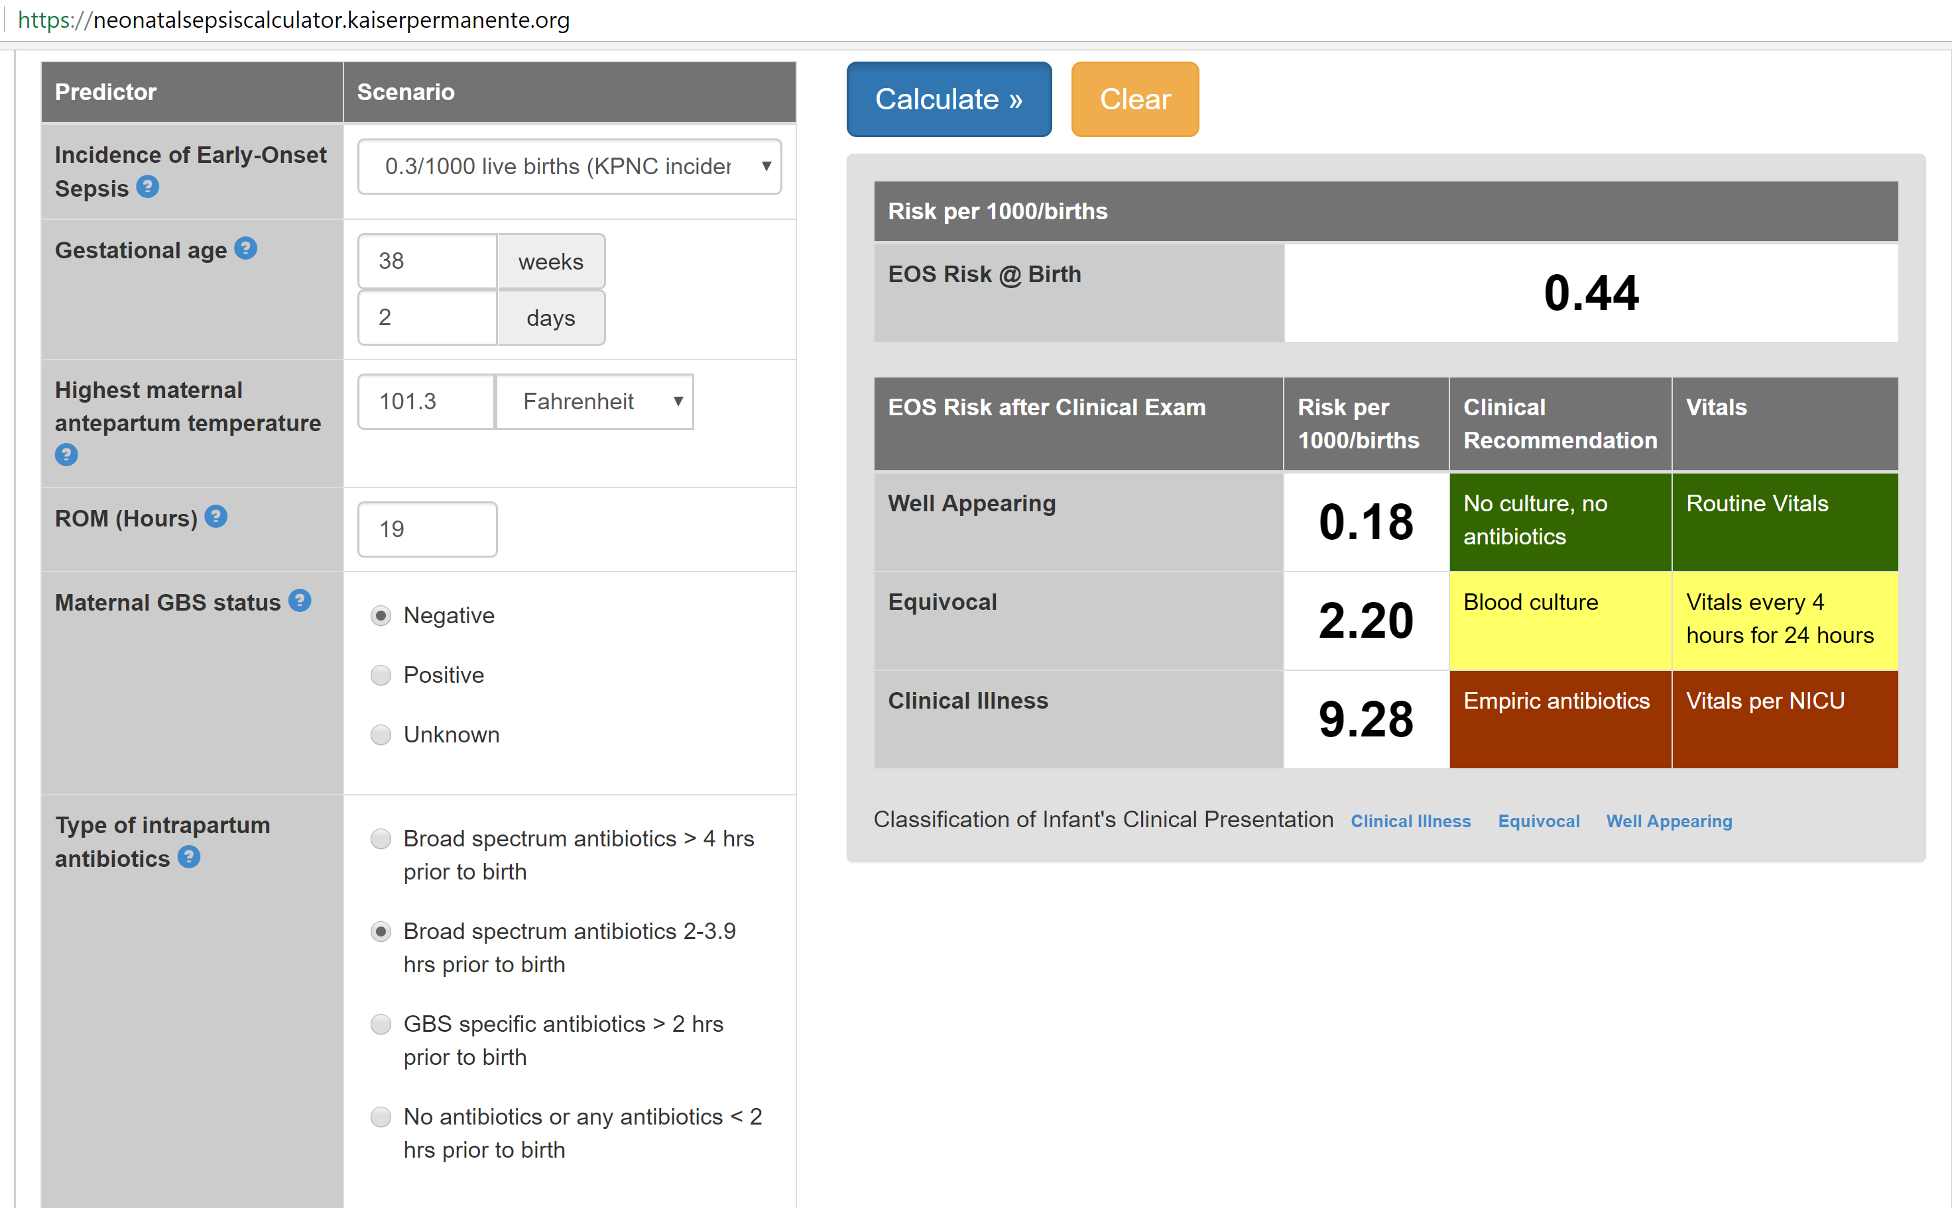

Slide 28
Kaiser sepsis calculator
204,485 infants ≥35 weeks gestation born at Kaiser Permanente Northern California hospitals during a 5-year period (2010-15)
Included 9,049 infants (4.4%) born to mothers with intrapartum fever
Decreased sepsis evaluations by 67% and antibiotic utilization by 50%

Slide 29
Kaiser sepsis calculator
51 infants with early-onset sepsis; only 1 out of 204,485 was missed by the calculator:
Mother GBS+ and intrapartum fever to 100.4
Infant well-appearing
Calculator recommended observation
Tachypnea at 36 hours of life → cultured
Tachypnea resolved, discharged home
Culture subsequently grew E. coli
Infant readmitted, repeat blood and CSF cultures sterile

Slide 30
Infant management
If antibiotics are initiated, 36 (24?) hours of empiric therapy is sufficient if appropriately-obtained blood cultures remain sterile
Our center does not modify duration of therapy based on whether mothers received adequate intrapartum antibiotic treatment or not

Slide 31
Infant management
Chorioamnionitis does not always (or often) equate to fetal infection
Intrapartum maternal antibiotics can sterilize fetal blood – that’s the point!
Chorio-exposed infants with sterile cultures account for a substantial fraction (5-15%) of antibiotic use in the NICU setting
Cantey et al. Lancet Inf Dis. 2016; 16(10): 1178-84.

Slide 32
Are ancillary lab tests useful?
Jackson et al. Pediatrics 2004; 113(5): 1173-80.
Prospective study of 856 chorio-exposed infants ≥35 weeks gestation
Complete blood counts with differential obtained at birth, 12, and 24 hours
99% of asymptomatic infants had at least 1 abnormal value
Specificity of abnormal CBC values was ~12%

Slide 33
Are ancillary lab tests useful?
Howman et al. PLoS One 2012; 7(12): e51836
325 infants in Perth, Australia
Median gestational age 34 weeks
10.5% incidence of chorioamnionitis
Higher CRP and procalcitonin from cord blood in chorio-exposed versus unexposed infants that lasted up to 48 hours after delivery
However, no correlation with early-onset sepsis

Slide 34
Long-term risks of chorio?
Neurodevelopmental injury (NDI)?
Bronchopulmonary dysplasia (BPD)?
Retinopathy of prematurity (ROP)?

Slide 35
NDI
Pappas et al. JAMA Peds 2014; 168(2): 137-47
Cohort study of 2,390 infants born <27 weeks gestation in the NICHD NRN who had placental histopathology and Bayley-III evaluations

Slide 36
Pappas et al. (con’t)
Chorio-exposed infants were more preterm and had higher rates of early-onset sepsis and intraventricular hemorrhage
After adjustment for covariates, clinical chorioamnionitis associated with increased risk of death or neurodevelopmental disability at 18 months (60% vs. 52%, NNH 12.5)
Histologic chorioamnionitis alone not associated with increased risk (51% vs 52%).

Slide 37
Histological Chorio
Miyazaki et al. J MFM 2016; 29(2): 331-7
5,849 very-low-birth-weight (<1500 g) infants in the Japanese neonatal research network between 2003-2007
No impact of histological chorioamnionitis alone on death or neurodevelopmental disability before 3 years of age

Slide 38
BPD?

Slide 39
Inflammation
Chorio
Preterm delivery
Mechanical ventilation
BPD
Lung Development
Normal
Repair

Slide 40
BPD?
No difference in physiologic BPD in the Pappas et al. study of chorio-exposed infants <27 weeks gestation
Ballard et al J Perinatology 2016; 36: 1045-8.
1,687 VLBW infants, 44% with moderate or severe BPD
Gestational age and sepsis associated with BPD; but not chorioamnionitis (OR 1.2 [95% CI 0.7-2.1])

Slide 41
The Argument
Thomas W. Chorioamnionitis is essential in the evolution of BPD – the case in favour.
Lacaze-Masmonteil T. That chorioamnionitis is a risk factor for bronchopulmonary dysplasia – the case against.
Pediatric Respiratory Reviews 2014; 15(1): 49-55.

Slide 42
ROP?

Slide 43
ROP?
Mitra et al. Neonatology 2014; 105: 189-99
Systematic review and meta-analysis of association between chorioamnionitis and ROP
27 studies, 10,590 infants included
Chorioamnionitis not associated with ROP after controlling for gestational age (RR 0.98 [95% CI 0.8 – 1.3])

Slide 44
Chorio
NDI,
BPD
ROP

Slide 45
Chorio
??
NDI,
BPD
ROP
Preterm Delivery

Slide 46
Conclusions
Chorioamnionitis is a major risk factor for preterm delivery and early onset sepsis
Symptomatic chorio-exposed infants require prompt evaluation and empiric treatment
Increasing evidence to support close observation without empiric antibiotics for asymptomatic chorio-exposed infants ≥35 weeks gestation

Slide 47
Conclusions
Ancillary lab tests (eg, CBC, CRP) are likely to be abnormal in chorioamnionitis-exposed infants. Abnormal values have little clinical utility and should not alter clinical management
Histologic chorioamnionitis alone (in the absence of clinical signs) should not change the management of the infant(s) or the mother

Slide 48
Conclusions
Most long-term morbidity from chorioamnionitis exposure seems to be mediated by preterm delivery…
…but some evidence linking clinical chorioamnionitis to increased risk of neurodevelopmental injury

Slide 49
Questions?
OKAPI Phone number: 210-880-9100
Email: cantey@uthscsa.edu
Twitter: @InfectiousNeo

