Slide 1
A Quantitative Approach to Early-Onset Sepsis
J.B. Cantey, MD, MPH
Ongoing Care of Congenital and Perinatal Infections (OKAPI) Program

Slide 2
Objectives
1) To update providers about the changing epidemiology of early-onset sepsis in the universal group B Streptococcus (GBS) screening era
2) To describe the sensitivity and specificity of blood cultures and ancillary laboratory tests for early-onset neonatal sepsis
3) To demonstrate the clinical utility of predictive scoring models such as the Kaiser sepsis calculator for early-onset neonatal sepsis

Slide 3
Definition
Early-onset sepsis (EOS):
Refers to positive culture from a sterile site, usually blood
Obtained within 72 hours of life (usually 0-6 hours)
Infection acquired perinatally due to factors associated with delivery
Distinct from late-onset sepsis, which is nosocomial infection, virtually always among preterm infants who require prolonged hospitalization

Slide 4
Epidemiology
In the United States, the incidence of EOS has decreased to approximately 0.4-0.5 per 1000 live births among infants ≥35 weeks gestation
Approximately 50% of these (0.24 per 1000 live births) are due to GBS; an additional 25-30% are due to gram-negative organisms such as E. coli

Slide 5
Epidemiology
A wide variety of organisms account for those last 20% (approximately 1 case out of every 12,500 infants), including other streptococci (group A and C streptococci), Listeria, Salmonella, Capnocytophaga, etc.
However, GBS and E. coli account for the bulk of EOS

Slide 6
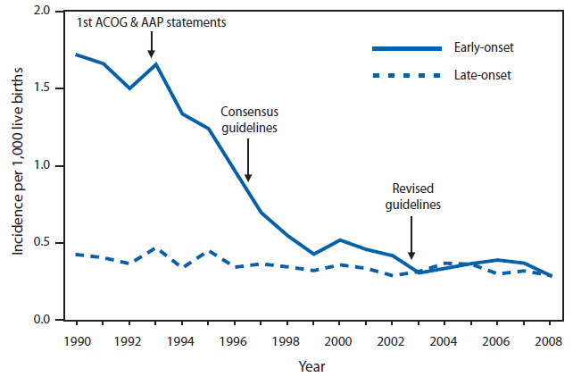
GBS Epidemiology
Most recent data from surveillance network is 2016; early onset cases now down to 0.22 per 1000 live births

Slide 7
However, a lot of our clinical practices were developed when the risk of EOS was much higher

Slide 8
Risk Factors
There are 4 risk factors for EOS
Prematurity and low birth weight are major risk factors for EOS
Infants <1500 g are at 20-fold increased risk for EOS compared with term infants
Chorioamnionitis
Approximately 50% of EOS infants are born to mothers with chorio
Varying definitions of chorioamnionitis, but usually require maternal fever at a minimum
Prolonged rupture of membranes
Rupture >18 hours is associated with increased risk for EOS, even in the absence of chorioamnionitis
Maternal GBS carriage
This risk can be mitigated by universal screening and intrapartum antibiotic prophylaxis for GBS+ mothers

Slide 9
Clinical Findings
Clinical signs of EOS are very nonspecific
Respiratory distress and temperature instability are the “most” common findings but are present in <50% of infants
Many non-infectious conditions mimic EOS, including transient tachypnea of the newborn, respiratory distress syndrome, pneumothorax, maternal anesthesia, being an infant of a diabetic mother, etc, etc…

Slide 10
Clinical Findings
The majority of infants will have signs of infection at birth or within the first 6-12 hours after delivery.
<25% have onset of symptoms beyond 12 hours
<10% have onset of symptoms beyond 24 hours
<1% have onset of symptoms beyond 48 hours
This is why observation for 48 hours is a reasonable strategy for lower-risk infants in the GBS guidelines

Slide 11
Diagnosis
The gold standard to diagnose EOS is blood culture
Minimum of 1 mL should be obtained for culture
No difference in sensitivity between 1 mL in 1 bottle or 0.5 mL each in 2 bottles; second doubles the risk for contamination but allows contaminants to be differentiated from real infection (eg, if 1 of 2 bottles grows Viridans group streptococci.)
Urine culture not indicated
Cerebrospinal fluid culture not routinely indicated
Would recommend lumbar puncture for infants with positive blood cultures OR for infants with overt neurologic signs (eg, seizure, apneas, etc)

Slide 12
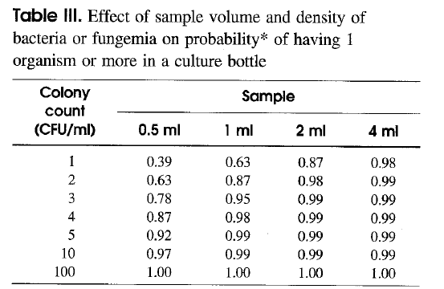
Blood culture sensitivity
Blood cultures are extremely sensitive to even low levels of bacteremia
Median CFU/mL for infants with early onset sepsis is 50-100
From: Schelonka RL, et al. J Pediatr. 1996; 129: 275.

Slide 13
Ultra-low colony-count sepsis?
Sensitivity of blood culture lower for infants with ultra-low colony count bacteremia (<4 CFU/mL)
HOWEVER
Limited evidence suggests that infants with <4 CFU/mL are not symptomatic
Infant’s innate immune system (circulating antibody, complement, phagocytes) may be enough to deal with ultra-low colony counts
36-48 hours of empiric antibiotic therapy is likely more than enough to help clear the bloodstream

Slide 14
From: Cantey JB, et al. Pediatrics. 2017; 140: e20170044.

Slide 15
Ancillary Lab Tests
Non-culture based ancillary testing includes complete blood count with differential, C-reactive protein, procalcitonin, et cetera.
In general, these markers have good negative predictive value and poor positive predictive value
Normal CBC or CRP is reassuring
Abnormal CBC or CRP is less meaningful because many noninfectious conditions make these values abnormal, including pre-eclampsia, maternal anesthesia, hypoxic-ischemic injury, in-utero growth restriction, etc.

Slide 16
Ancillary Lab Tests
 | Early-onset sepsis | No infection | Total
IT ratio abnormal | 6 | 634 | 640
IT ratio normal | 3 | 1430 | 1433
Total | 9 | 2064 | 2073
Sensitivity: 67%; Specificity: 69%
Positive predictive value: 1.4%
Negative predictive value: 99.7%
Adapted from Mikhael M, et al. J Pediatr. 2014; 164(3): 522.

Slide 17
Ancillary Lab Tests
Sensitivity not good enough to use as a “screening test” – still need blood culture if EOS suspected
Specificity not good enough to treat for “culture-negative” sepsis – most abnormal ancillary lab tests are not due to infection
Positive predictive value is terrible
NEGATIVE PREDICTIVE VALUE is where ancillary lab tests shine – if culture is sterile, even if infant still has clinical signs of sepsis, a normal ancillary lab test can provide additional confidence that the infant does not have early onset sepsis.

Slide 18
Treatment
Ampicillin and gentamicin remain the preferred regimen for suspected EOS
Ampicillin covers GBS and other streptococci as well as Listeria
Gentamicin covers most gram-negative organisms
Gentamicin resistance should be monitored by your hospital’s microbiology lab and summarized in the antibiogram, usually updated annually or semiannually.
Note – gentamicin does not penetrate into cerebrospinal fluid well, so alternative therapy (3rd or 4th generation cephalosporin) should be used if gram-negative meningitis is suspected or proven

Slide 19
Needle in the Haystack

Slide 20
Needle in the Haystack – Respiratory distress
Approximately 5-7% of term newborns have respiratory distress at birth (125-175 per 2500 live births)
However, only 0.04% of them will have EOS (1 per 2500 live births)

Slide 21
Needle in the Haystack
150 infants with respiratory distress
2350 infants without respiratory distress

Slide 22
Needle in the Haystack
1 infant with
early-onset sepsis
150 infants with respiratory distress

Slide 23
Needle in the Haystack – Chorioamnionitis
Approximately half of infants with EOS are exposed to chorioamnionitis
85-90% of chorio-exposed infants with EOS have signs of sepsis
What to do about the 10-15% who are initially asymptomatic?
Wortham JM, et al, Pediatrics. 2016; 137(1).
Depending on your institution’s rate of chorioamnionitis, the number of sepsis evaluations among well-appearing, chorio-exposed infants needed to identify 1 newborn with EOS is approximately 700 (5% chorio prevalence)
NNT ranges from 60 (0.5% chorio prevalence) to 1400 (10% chorio prevalence)

Slide 24
Review
EOS is rare (1 in 2000-2500 live births)
4 risk factors for EOS
Prematurity
Chorioamnionitis
Prolonged rupture of membranes
Maternal group B streptococcal colonization (and intrapartum prophylaxis, if indicated)
Most infants with EOS are symptomatic and symptomatic early

Slide 25
Sepsis calculator
Uses the 4 objective risk factors for EOS to calculate risk
Gestational age
Maternal temperature
Rupture of membranes
Maternal GBS status and intrapartum antibiotic prophylaxis
Provides recommendations based on well-appearing, equivocal, and clinically ill infants

Slide 26
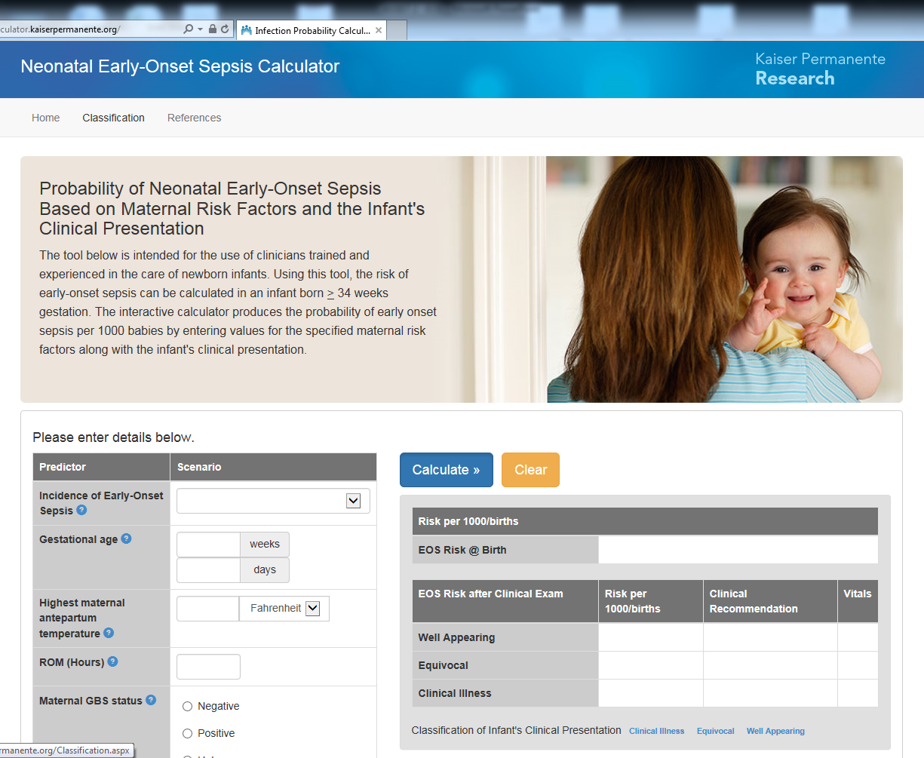
https://neonatalsepsiscalculator.kaiserpermanente.org/

Slide 27
Example #1 – The sick newborn
38 4/7 week infant, born to a 28 year old G2P2 mother via spontaneous vaginal delivery. Membranes were ruptured for 12 hours; no chorioamnionitis was identified. Highest maternal temperature was 99.1 F. Mother was GBS+ and received adequate intrapartum therapy with penicillin for 3 doses. On examination, the infant is tachypneic to the 80s and grunting intermittently.

Slide 28
Example #1 – The sick newborn
38 4/7 week infant, born to a 28 year old G2P2 mother via spontaneous vaginal delivery. Membranes were ruptured for 12 hours; no chorioamnionitis was identified. Highest maternal temperature was 99.1 F. Mother was GBS+ and received adequate intrapartum therapy with penicillin for 3 doses. On examination, the infant is tachypneic to the 80s and grunting intermittently = SICK

Slide 29
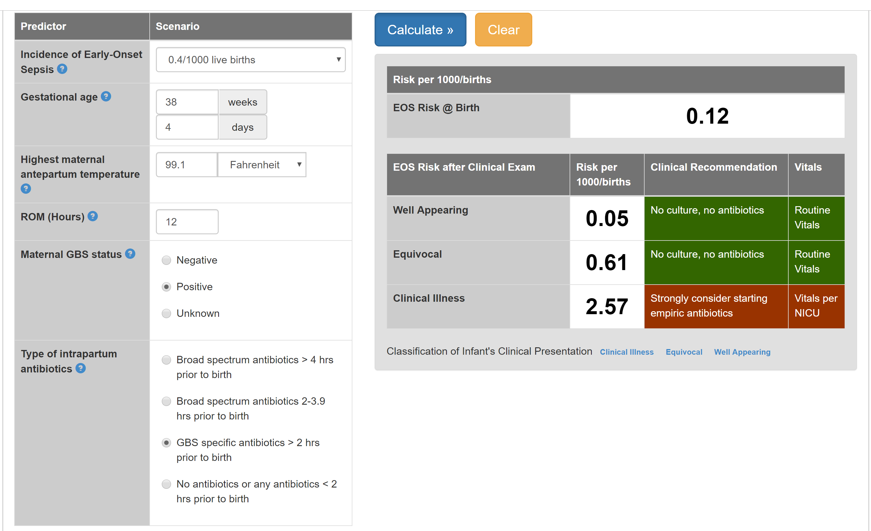

Slide 30
Example #2 – The equivocal newborn
39 1/7 week infant, born to a 18 year old primigravida via cesarean delivery. Membranes were ruptured for 21 hours, no chorioamnionitis was identified. Highest maternal temperature was 99.5 F. Mother was GBS negative. On examination, the infant is mildly tachypneic to the 70s but otherwise breathing comfortably and has breast fed once.

Slide 31
Example #2 – The equivocal newborn
39 1/7 week infant, born to a 18 year old primigravida via cesarean delivery. Membranes were ruptured for 21 hours, no chorioamnionitis was identified. Highest maternal temperature was 99.5 F. Mother was GBS negative. On examination, the infant is mildly tachypneic to the 70s but otherwise breathing comfortably and has breast fed once = EQUIVOCAL.

Slide 32
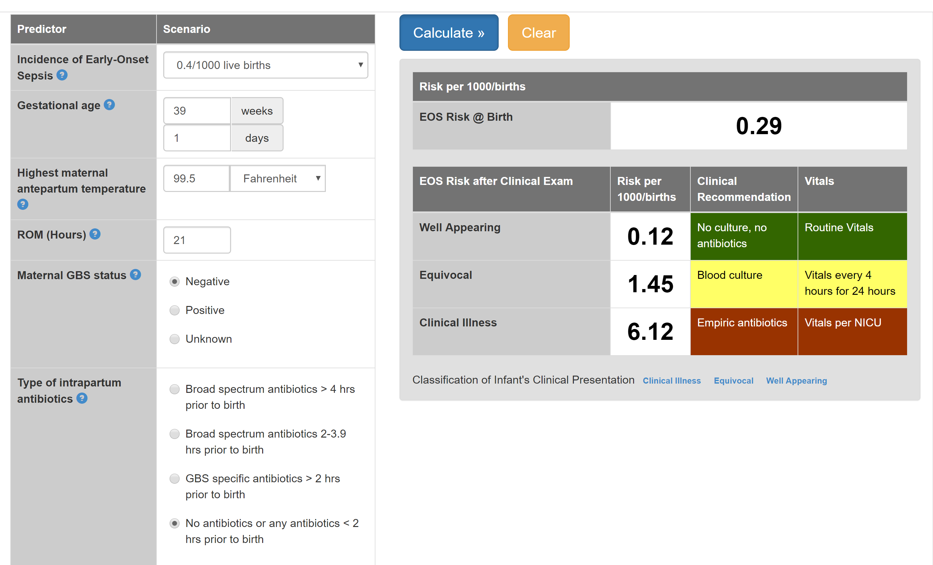

Slide 33
Example #3 – The well-appearing newborn
38 6/7 week infant, born via forceps-assisted vaginal delivery to a 25 year old G3P2A1. Membranes were ruptured for 13 hours. The obstetrician was concerned for chorioamnionitis. Highest maternal temperature was 102.1. Mother was GBS negative, and received ampicillin and gentamicin 3 hours prior to delivery due to suspected chorioamnionitis. On examination, the infant is breathing comfortably, has normal tone, and has nursed once.

Slide 34
Example #3 – The well-appearing newborn
38 6/7 week infant, born via forceps-assisted vaginal delivery to a 25 year old G3P2A1. Membranes were ruptured for 13 hours. The obstetrician was concerned for chorioamnionitis. Highest maternal temperature was 102.1. Mother was GBS negative, and received ampicillin and gentamicin 3 hours prior to delivery due to suspected chorioamnionitis. On examination, the infant is breathing comfortably, has normal tone, and has nursed once = WELL-APPEARING.

Slide 35
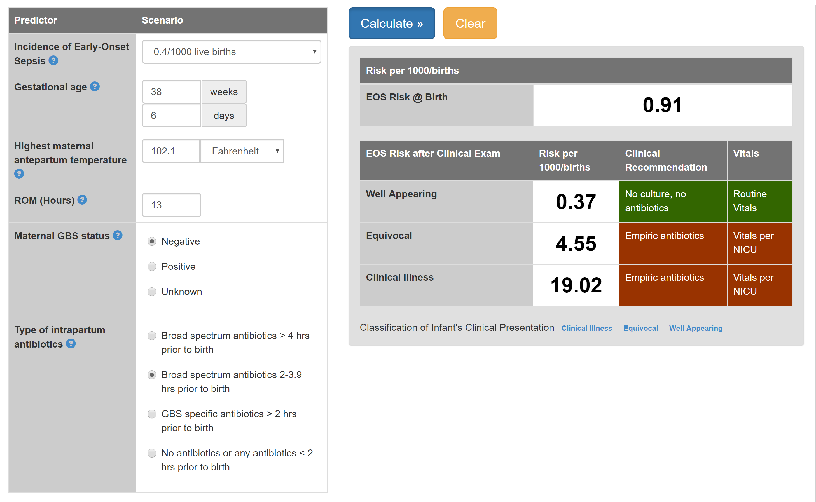

Slide 36
Safety of the sepsis calculator
Kuzniewicz MW, et al. JAMA Pediatr. 2017; 171(4): 365
Prospective pre/post cohort during the rollout of the Kaiser sepsis calculator in Kaiser system nurseries from 2010-2015
204,485 infants ≥35 weeks gestation included
Primary outcome = number of sepsis evaluations
Safety outcomes = positive cultures, NICU admissions, readmissions, death
Sepsis calculator reduced blood cultures by 70% and antibiotic use by 50%
No increase in sepsis, NICU admission, readmissions, or death
1 infant with missed EOS, had good clinical outcome, would also have been missed by traditional CDC or 2012 AAP guidelines

Slide 37
Safety of the sepsis calculator
Numerous other studies have evaluated the sepsis calculator prospectively and retrospectively
Safe and effective for chorioamnionitis-exposed infants
Safe for late preterm infants cared for in level 1 nurseries (35-36 weeks)
Safe for post-dates infants (41-43 weeks)
Included as an official recommendation in the 2018 American Academy of Pediatrics neonatal sepsis guidelines!!

Slide 38
Suggested Reading
Stoll BJ, et al. Early onset neonatal sepsis: the burden of group B streptococcal and E. coli disease continues. Pediatrics. 2011; 127(5): 817.
Reuter S, et al. Respiratory distress in the newborn. Pediatrics in Review. 2014; 35(10): 417.
Kuzniewicz MW, et al. A quantitative, risk-based approach to the management of neonatal early-onset sepsis. JAMA Pediatr. 2017; 171(4): 365

Slide 39
Email: cantey@uthscsa.edu
OKAPI Program: 210-880-9100
Twitter: @OKAPIprogram

